Slide 1


SOLOMON KOBBY EWUDZIE
8 APR 23

Slide 2

Outline
Executive Summary
Introduction
Methodology
Results
Conclusion
Appendix

Slide 3
Executive Summary
There is need to determine using Data Science if SpaceX will reuse the first stage of its space rockets to assist Space Y compete.
Data collection, Data wrangling was performed to acquire workable data. Exploratory data analysis (EDA) was performed using visualization and SQL. Interactive visual analytics was performed using Folium and Plotly Dash. Predictive analysis was performed using classification models.
It was found that Booster version FT with payload between 2000 and 6000 is more likely to be reused. KSC-LC-39A is the launch site with highest success count and success ratio. Lower orbit travels have higher success rates.
Predictive models had a good accuracy (83%) in classifying whether a stage 1 would land successfully to be reused.

Slide 4
Introduction
Stage one does most of the work in moving a spaceship to space. This stage is quite large and expensive. Unlike other rocket providers, SpaceX's Falcon 9 Can sometimes recover the first stage thereby reducing overall costs by half. At other times it will crash
Space Y that would like to compete with SpaceX.
Need to gather information about Space X and create dashboards for the team.
Need to determine using Data Science if SpaceX will reuse the first stage.
This will assist Space Y to know how to compete in upcoming launches.

Slide 5

Section 1

Slide 6
Methodology
Executive Summary
Data collection methodology:
Describes how data was collected
Perform data wrangling
Describes how data was processed
Perform exploratory data analysis (EDA) using visualization and SQL
Perform interactive visual analytics using Folium and Plotly Dash
Perform predictive analysis using classification models
How classification models were built, tuned and evaluated

Slide 7
Data Collection
Done through API calls and webscraping.

Slide 8
Data Collection – SpaceX API
Assign API url to variable
spacex_url
Make request.get call to API
Check the content using response.content
GitHub URL https://github.com/kobbystorm1/IBM-COURSER/blob/master/jupyter-labs-spacex-data-collection-api.ipynb

Slide 9
Data Collection - Scraping
Create dataframe using pd.json_normalize()
Extract launch Relevant data columns to create new dataframe.
Filter dataframe to only Falcon 9 launches.
GitHub URL https://github.com/kobbystorm1/IBM-COURSER/blob/master/jupyter-labs-spacex-data-collection-api.ipynb

Slide 10
Data Wrangling
Replace missing Payload values with the mean using
.fillna()
Calculate number of launches per site using
.value_counts()
Calculate number and occurrence of each orbit
Calculate number and occurrence of mission outcome per orbit type
Create a landing outcome label from Outcome column
GitHub URL https://github.com/kobbystorm1/IBM-COURSER/blob/master/labs-jupyter-spacex-Data%20wrangling.ipynb

Slide 11
EDA with Data Visualization
Create Scatter point chart of Flight Number vs launch site.
Create Scatter point chart of relationship between Payload and Launch Site.
Create Bar chart of success rate of each orbit type.
Create Scatter point chart of relationship between Flight Number and Orbit type.
Create Scatter point chart of relationship between Payload and Orbit type.
Create Line chart of launch success yearly trend.
GitHub URL https://github.com/kobbystorm1/IBM-COURSER/blob/master/IBM-DS0321EN-SkillsNetwork_labs_module_2_jupyter-labs-eda-dataviz.ipynb.jupyterlite.ipynb

Slide 12
EDA with SQL
Display the names of the unique launch sites in the space mission.
Display 5 records where launch sites begin with the string 'CCA’
Display the total payload mass carried by boosters launched by NASA (CRS)
Display average payload mass carried by booster version F9 v1.1
List the date when the first successful landing outcome in ground pad was achieved.
List the names of the boosters which have success in drone ship and have payload mass greater than 4000 but less than 6000
List the total number of successful and failure mission outcomes
GitHub URL https://github.com/kobbystorm1/IBM-COURSER/blob/master/jupyter-labs-eda-sql-coursera_sqllite.ipynb

Slide 13
EDA with SQL (cont)
List the names of the booster_versions which have carried the maximum payload mass.
List the records which will display the month names, failure landing_outcomes in drone ship ,booster versions, launch_site for the months in year 2015.
Rank the count of successful landing_outcomes between the date 04-06-2010 and 20-03-2017 in descending order.
GitHub URL https://github.com/kobbystorm1/IBM-COURSER/blob/master/jupyter-labs-eda-sql-coursera_sqllite.ipynb

Slide 14
Build an Interactive Map with Folium
Mark all launch sites on a map.
Mark the success/failed launches for each launch site.
Calculate the distances between a launch site to its proximities.
GitHub URL https://github.com/kobbystorm1/IBM-COURSER/blob/master/Interactive%20Visual%20Analytics%20with%20Folium%20lab.ipynb

Slide 15
Build a Dashboard with Plotly Dash
Add a Launch Site Drop-down Input Component to select all or single launch sites.
Create success-pie-chart based on selected Launch Sites.
Add a Range Slider to Select Payload.
Create success-payload-scatter-chart to see Payload success rates.
GitHub URL https://github.com/kobbystorm1/IBM-COURSER/blob/master/spacex_dash_app.py

Slide 16
Predictive Analysis (Classification)
Create a NumPy array from the column assign it to Y.
Standardize the data in X using StandardScaler() transform.
Use the function to split the data X and Y into training and test data using train_test_split .
Create a logistic regression, support vector machine, decision tree classifier, k nearest neighbors objects.
Create a GridSearchCV object of each classification method to find best parameters and Calculate the prediction accuracy on the test data.
Plot the confusion matrix for each classification method .
GitHub URL https://github.com/kobbystorm1/IBM-COURSER/blob/master/IBM-_SpaceX_Machine_Learning_Prediction_Part_5.jupyterlite.ipynb

Slide 17
Results
Exploratory data analysis results
Interactive analytics demo in screenshots
Predictive analysis results

Slide 18

Section 2

Slide 19
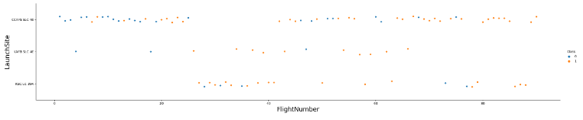
Flight Number vs. Launch Site
Scatter plot of Flight Number vs. Launch Site

Slide 20
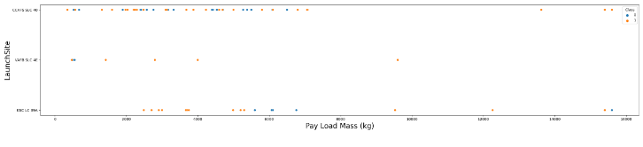
Payload vs. Launch Site
Scatter plot of Payload vs. Launch Site

Slide 21
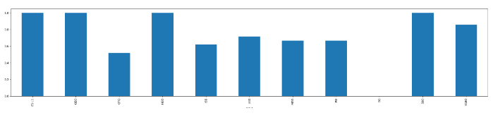
Success Rate vs. Orbit Type
Lower orbit travels have higher success rates

Slide 22
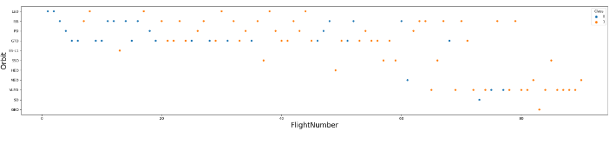
Flight Number vs. Orbit Type
Show a scatter point of Flight number vs. Orbit type

Slide 23
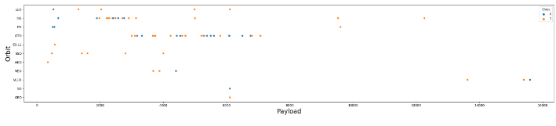
Payload vs. Orbit Type
Scatter point of payload vs. orbit type

Slide 24
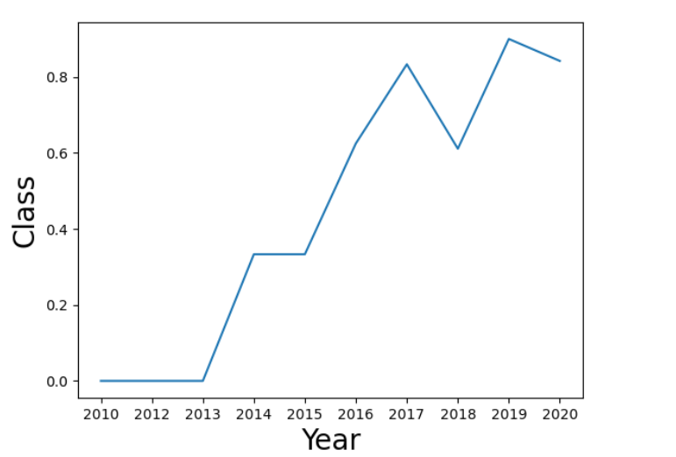
Launch Success Yearly Trend
Line chart of yearly average success rate

Slide 25
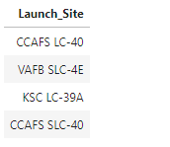
All Launch Site Names
Names of the unique launch sites

Slide 26
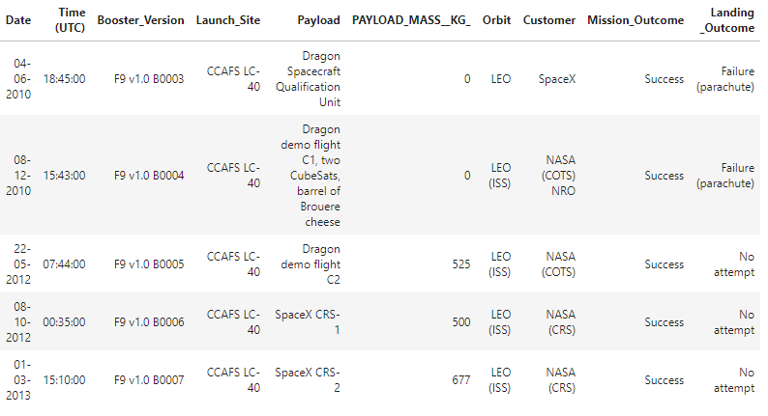
Launch Site Names Begin with 'CCA'
5 records where launch sites begin with `CCA`

Slide 27
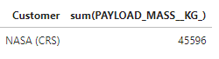
Total Payload Mass
Total payload carried by boosters from NASA

Slide 28
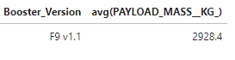
Average Payload Mass by F9 v1.1
Average payload mass carried by booster version F9 v1.1

Slide 29

First Successful Ground Landing Date
Date of the first successful landing outcome on ground pad

Slide 30
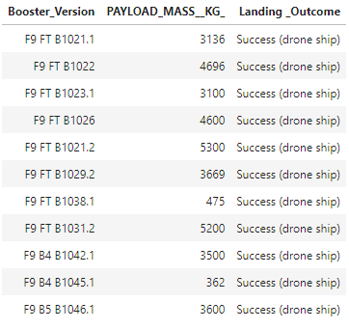
Successful Drone Ship Landing with Payload between 4000 and 6000
Names of boosters which have successfully landed on drone ship and had payload mass greater than 4000 but less than 6000

Slide 31
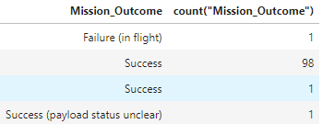
Total Number of Successful and Failure Mission Outcomes
Total number of successful and failure mission outcomes.

Slide 32
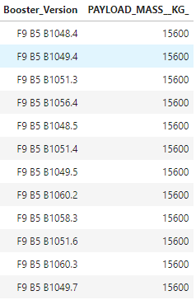
Boosters Carried Maximum Payload
Names of the booster which have carried the maximum payload mass

Slide 33
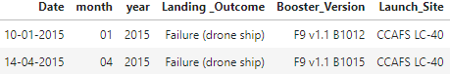
2015 Launch Records
Failed landing_outcomes in drone ship, their booster versions, and launch site names for in year 2015

Slide 34
Rank Landing Outcomes Between 2010-06-04 and 2017-03-20
Rank the count of landing outcomes (such as Failure (drone ship) or Success (ground pad)) between the date 2010-06-04 and 2017-03-20, in descending order

Slide 35

Section 3

Slide 36
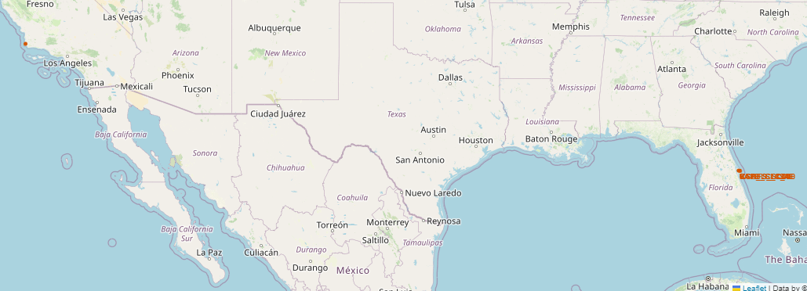
launch sites’ location markers on a global map
All Launch sites are by the coast

Slide 37
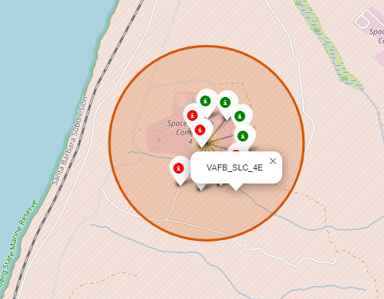
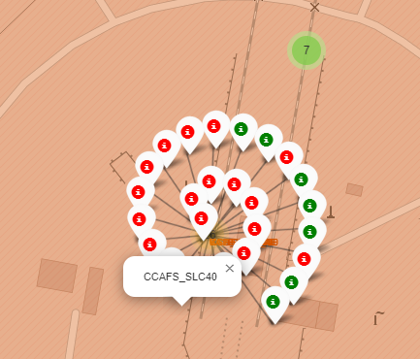
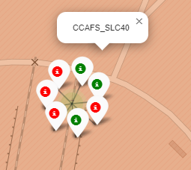
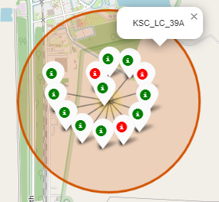
Color-labeled launch site outcomes
KSC-LC-39A is the launch site with highest success count

Slide 38
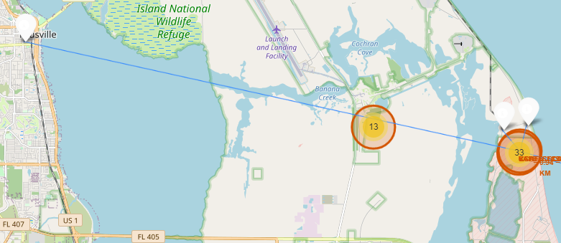
Launch site to its proximities marked
Launch sites are close to the coast, rail and highways for access but far from cities for safety

Slide 39

Section 4

Slide 40
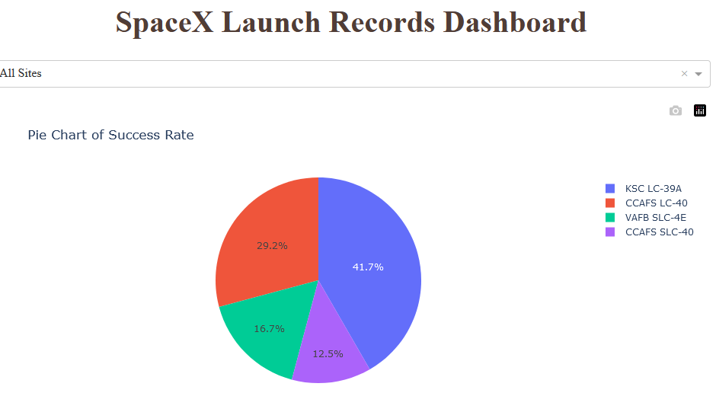
All launch sites success pie chart
KSC-LC-39A is the launch site with highest success count

Slide 41
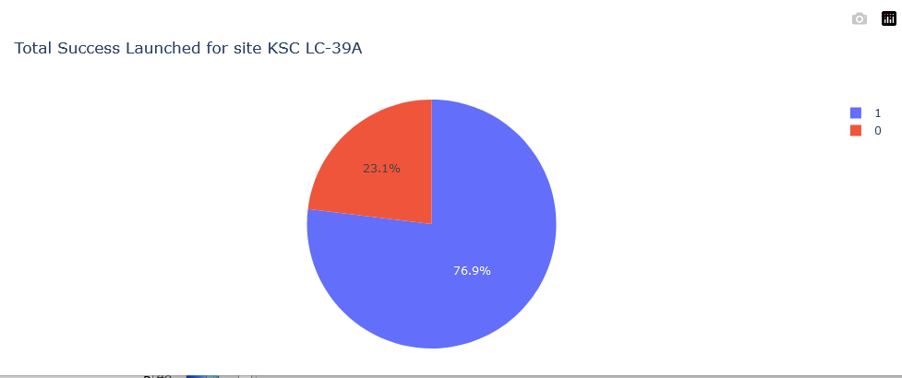
Launch site with highest launch success ratio
KSC-LC-39A has highest success ratio

Slide 42
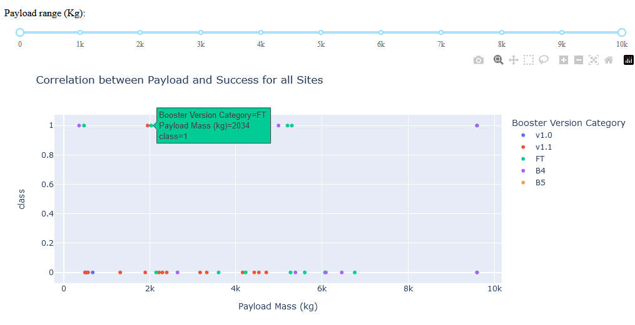
Payload vs. Launch Outcome scatter plot for all sites
Booster version FT with payload between 2000 and 6000 is more likely to be reused.

Slide 43

Section 5

Slide 44
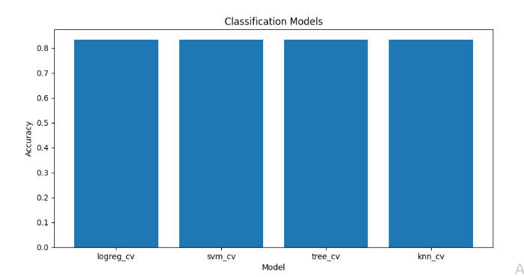
Classification Accuracy
All four models have the same accuracy score

Slide 45
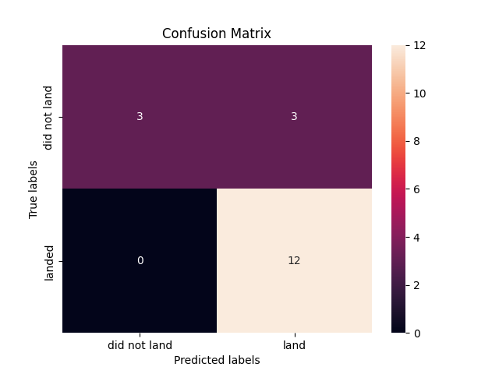
Confusion Matrix
All models are good at classification but possess a few false positives

Slide 46
Conclusions
KSC-LC-39A is the launch site with highest success count
KSC-LC-39A launch site has highest success ratio
Lower orbit travels have higher success rates.
Booster version FT with payload between 2000 and 6000 is more likely to be reused/succeed.
Predictive models had a good accuracy (83%) in classifying whether a stage 1 would land successfully to be reused.

Slide 47
Appendix
All data available in GitHub repository.
https://github.com/kobbystorm1/IBM-COURSER

Slide 48


